Slide 1




GROUP ASSESSMENT BY BASIL, MAXENE, AND PATRICK
FLEXIMED
THE MEDICAL HEALTH APP FOR EVERYONE

Slide 2


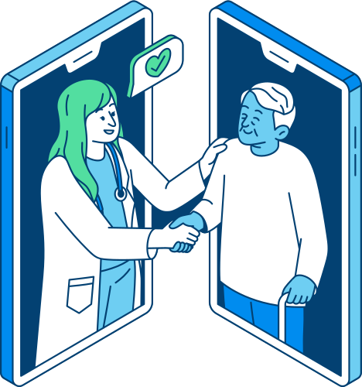

INTRODUCTION TO FLEXIMED
Fleximed is a health app where people can access their needed medical services on their phone.

Slide 3





LIMITATIONS OF HEALTH APPS IN GENERAL
Lack of physical examination
Technical Issues
Challenges with insurance coverage
Inadequate ability to address emergencies

Slide 4

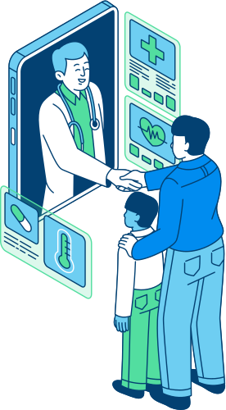


WHAT FLEXIMED OFFERS TO COMBAT HEALTH APP LIMITATIONS
Offers scheduling for in-home physical checkups by medical professionals
Highly secure mobile service to protect user information
Facilitates appointment scheduling process

Slide 5



MARKET OPPORTUNITY
FlexiMed is not only for the people who are in need but also for professionals who are looking for either another source of income, or a hobby

Slide 6



KEY FEATURES
RESPONSIVE DESIGN
CLEAN AND INTUITIVE INTERFACE
ACCESSIBILITY FEATURES
SECURE PATIENT INFORMATION

Slide 7


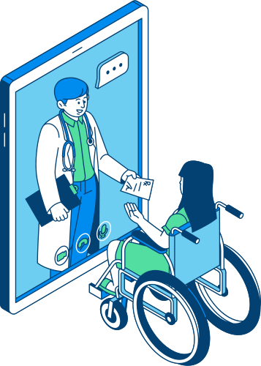

AUDIENCES
People who need Immediate Attention
Elderly
Physically Disabled

Slide 8


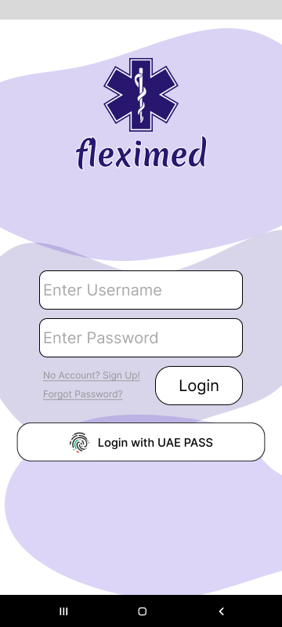
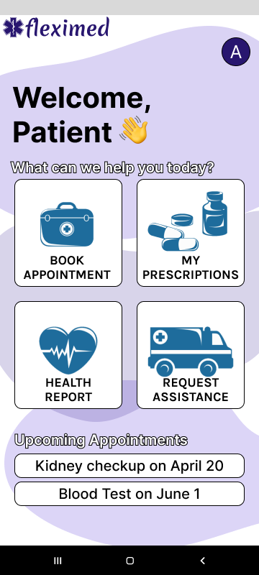
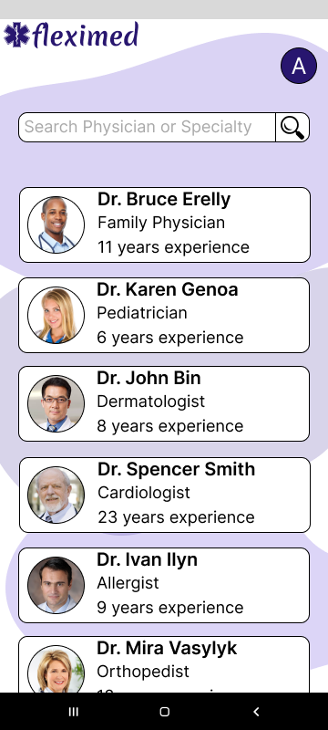
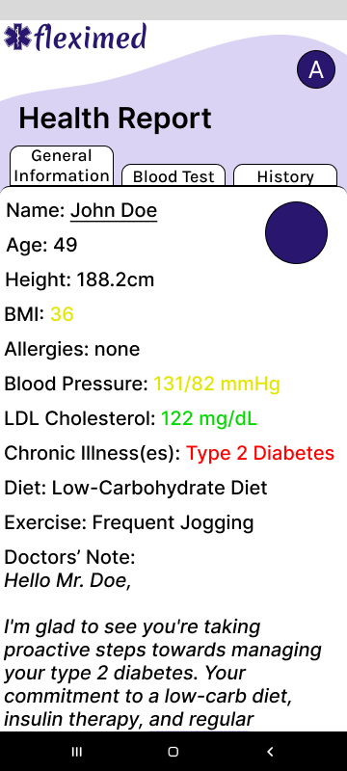
FLEXIMED APP
Login Page
Home Page
Available Doctors
Information Tab

Slide 9


COMPETITIVE LANDSCAPE
While FlexiMed is not the first healthcare app, there’s not a lot of apps that benefits not only to the patients, but also to the professionals. FlexiMed is also user-friendly, straightforward, and easy to use.

Slide 10





END

